Slide 1
FVID ETF (2019) ETFs 정보 제공 해외 밴치마크
July 1, 2019
이명원

Slide 2
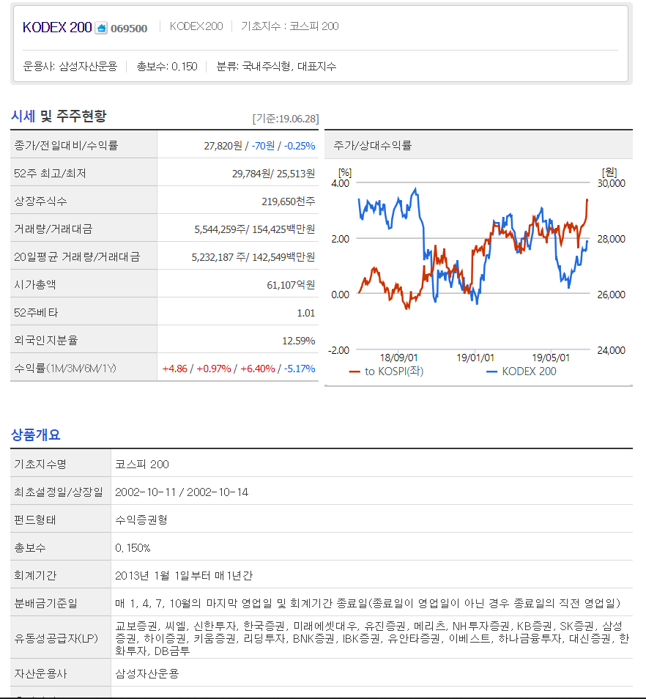
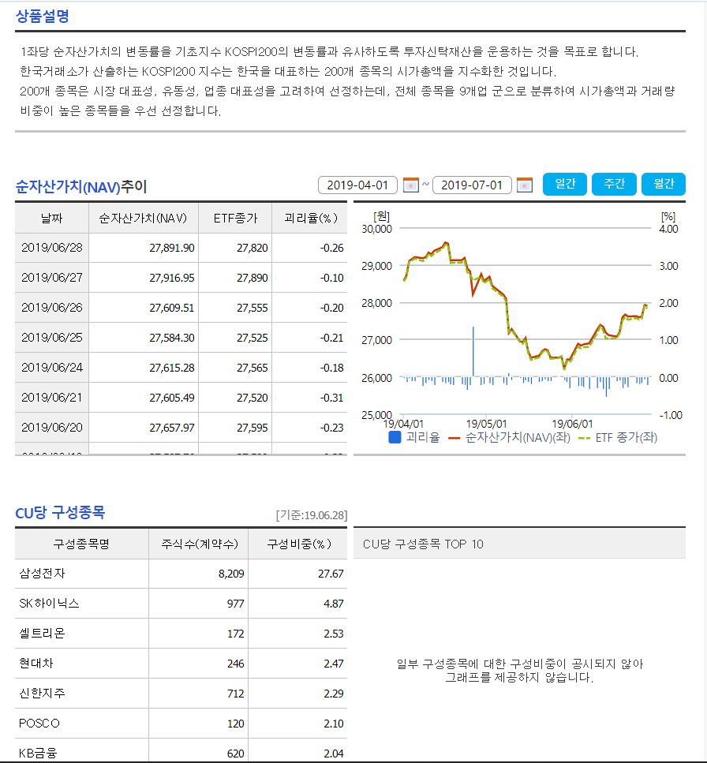
NAVER
https://finance.naver.com/item/coinfo.nhn?code=069500

Slide 3
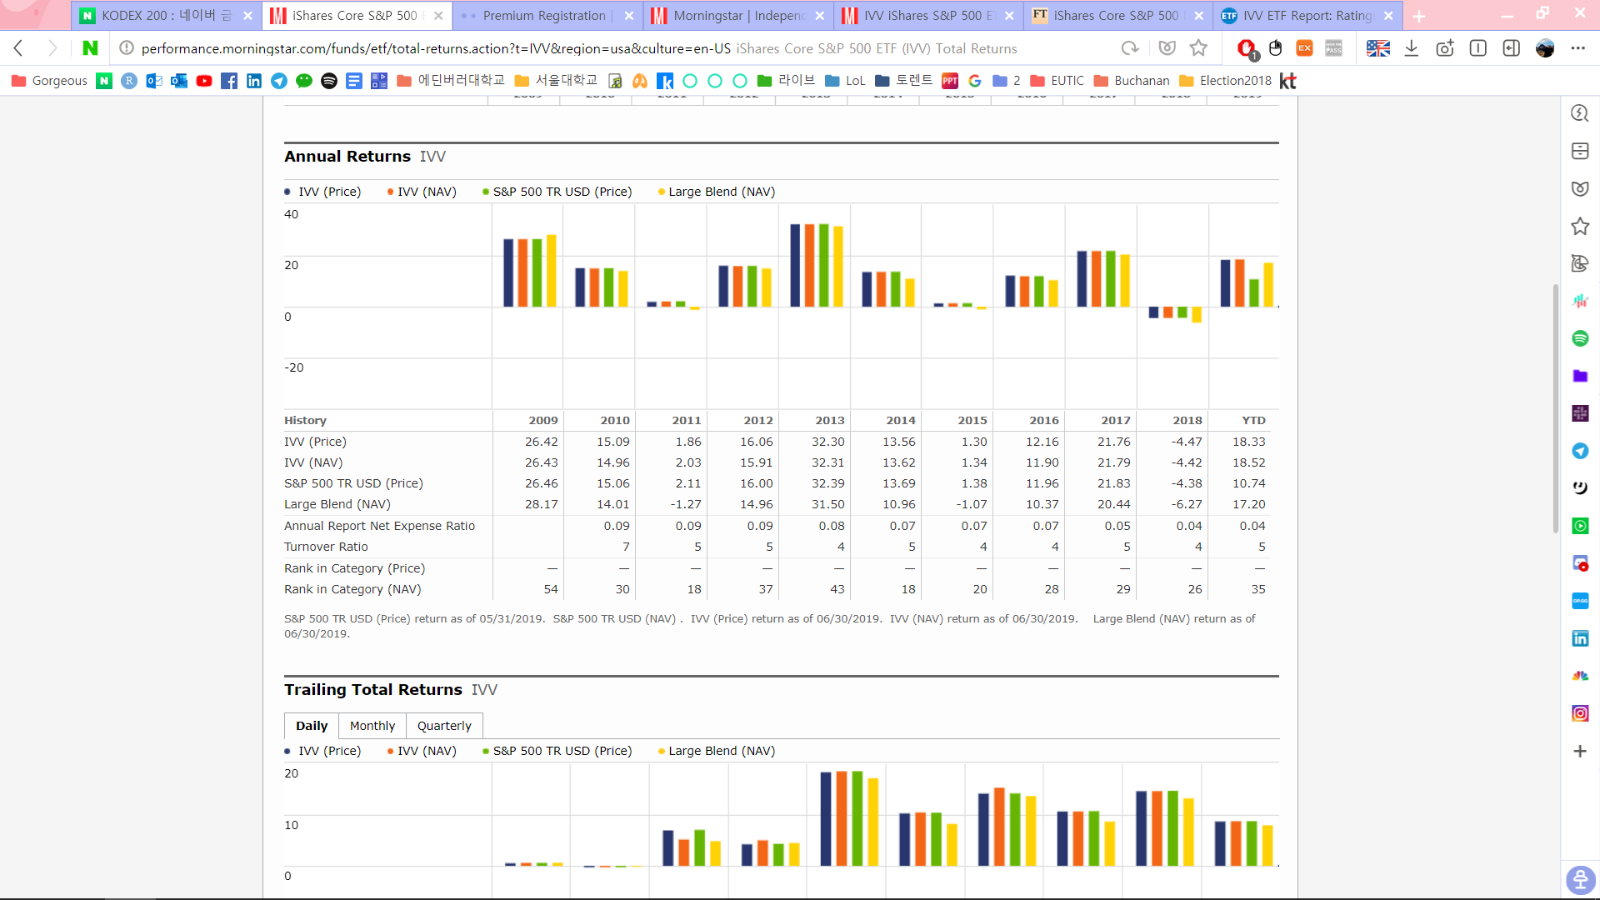
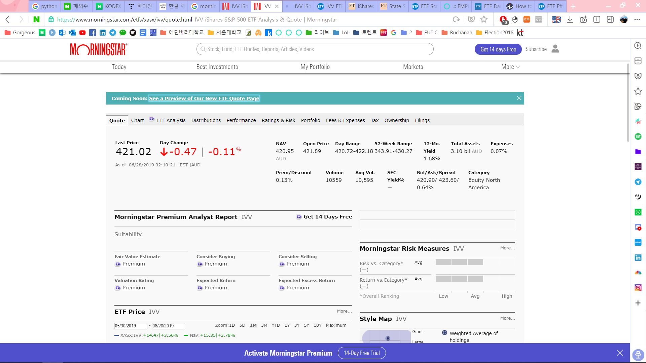
MorningStar
https://www.morningstar.com/etfs/ARCX/IVV/quote.html

Slide 4
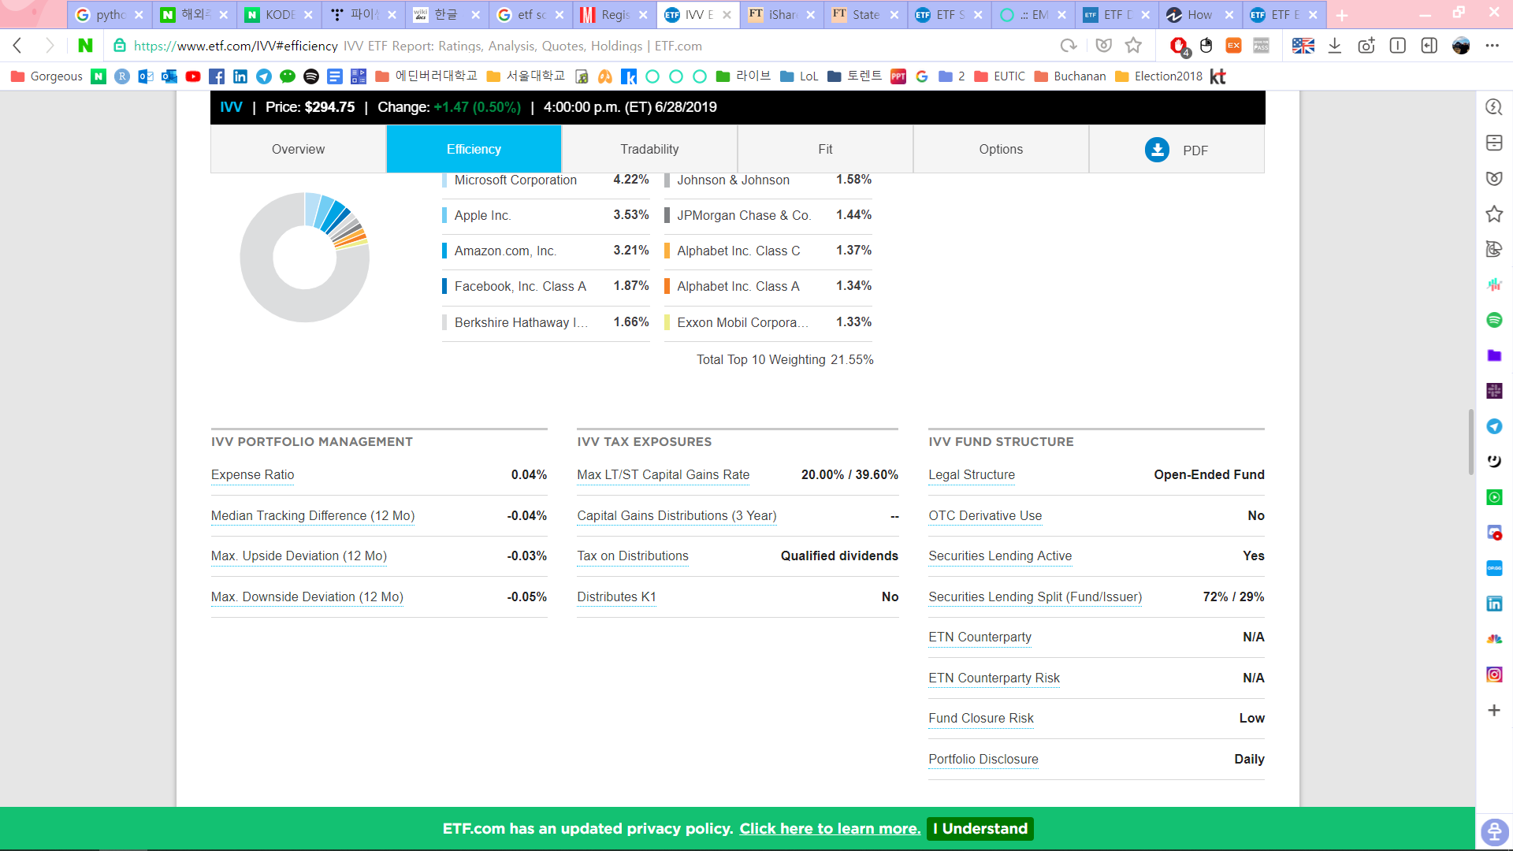
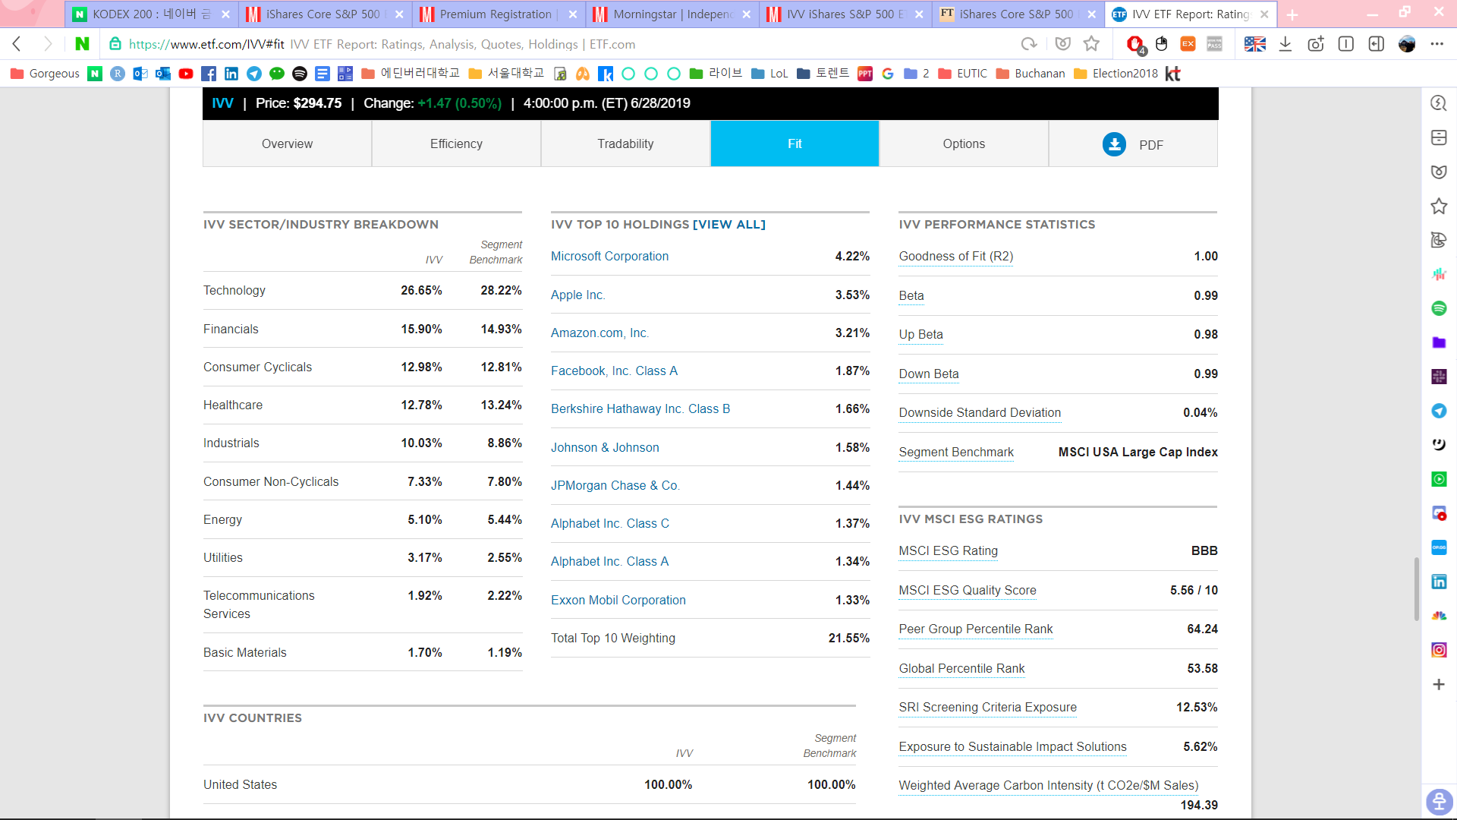
ETF.com
https://www.etf.com/IVV#fit

Slide 5
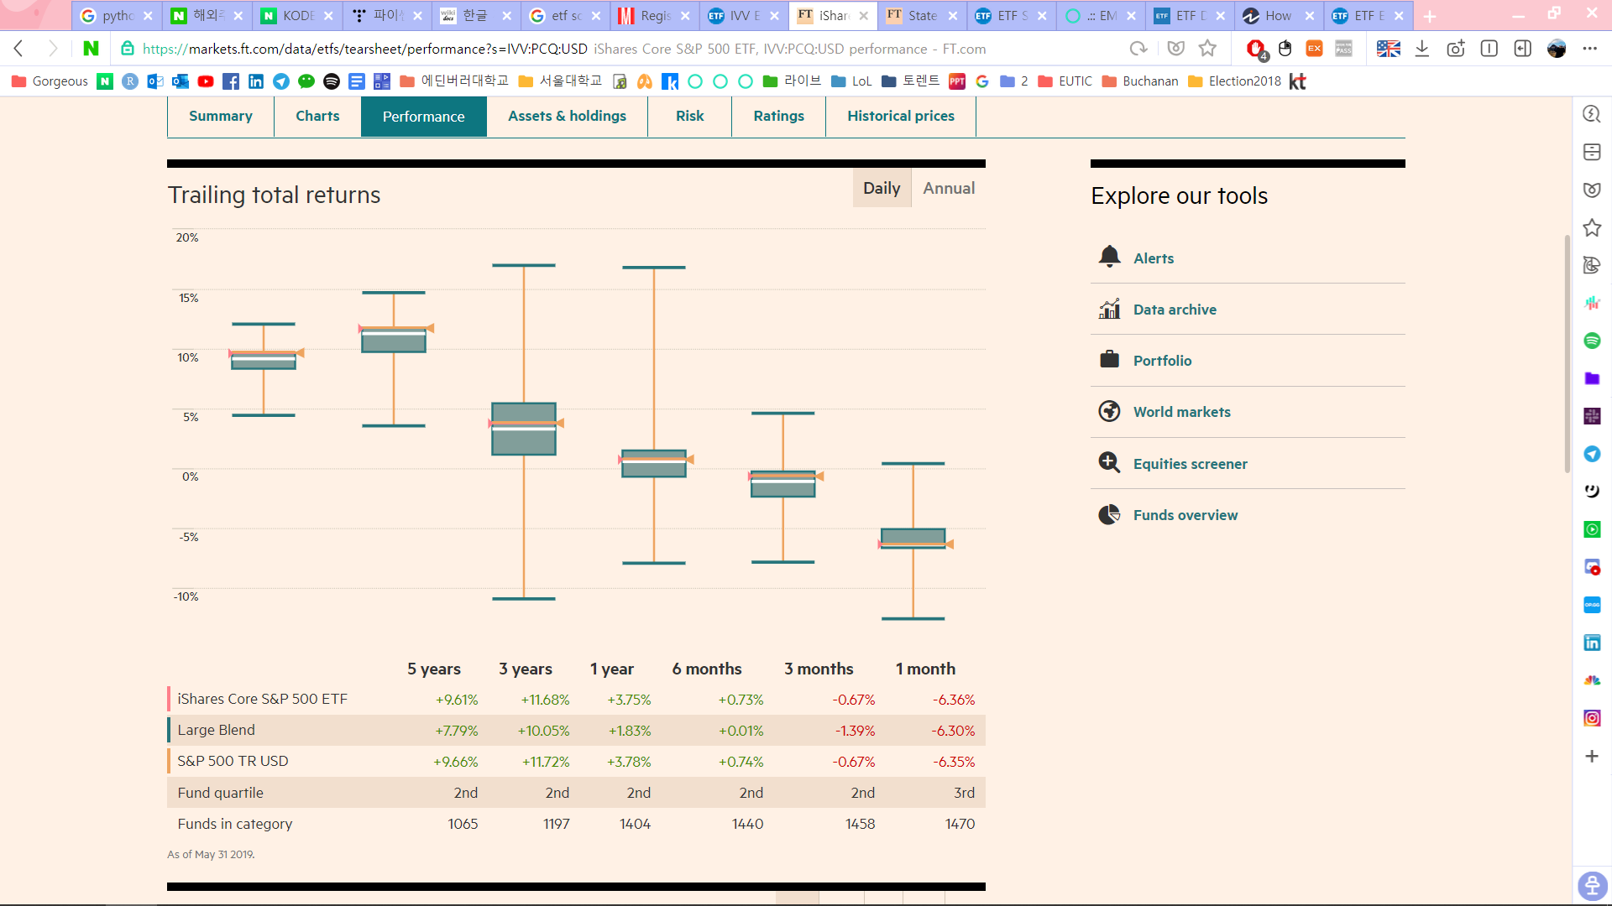
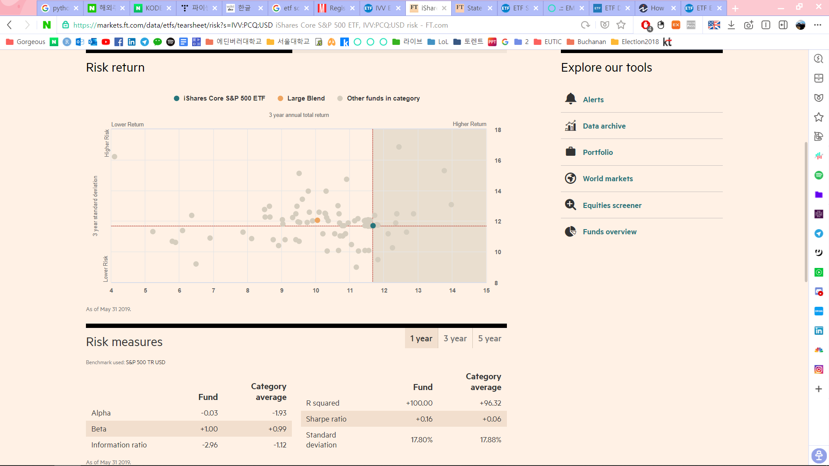
Financial Times
https://markets.ft.com/data/etfs/tearsheet/summary?s=IVV:PCQ:USD

Slide 6
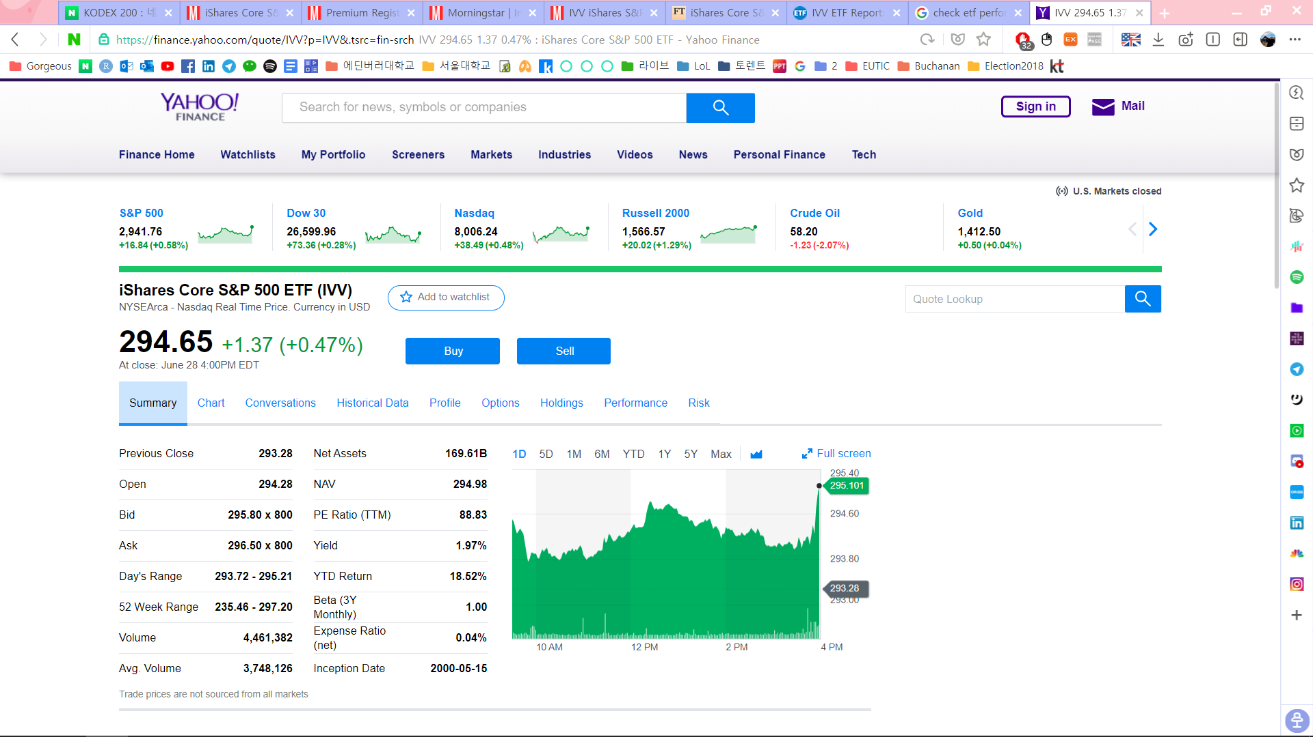
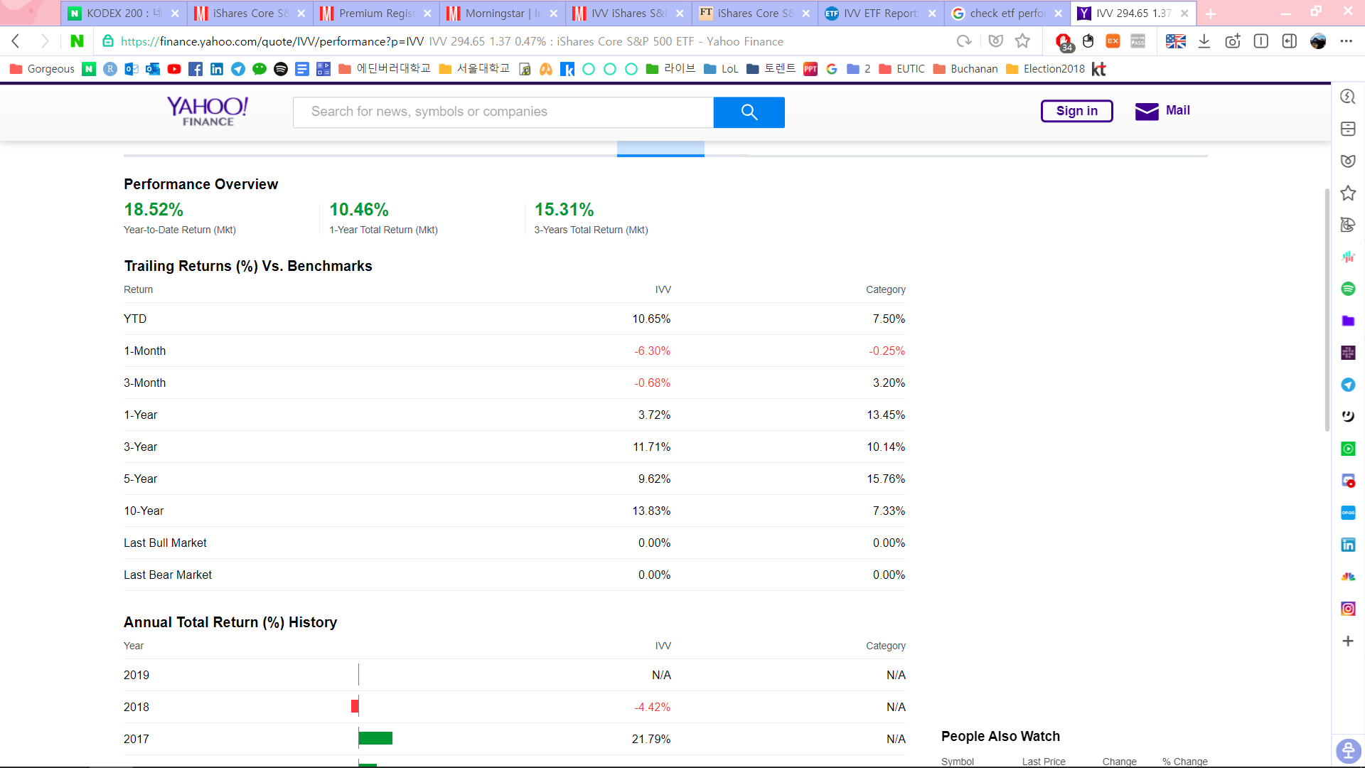
Yahoo Finance
https://finance.yahoo.com/quote/IVV?p=IVV&.tsrc=fin-srch

Slide 7
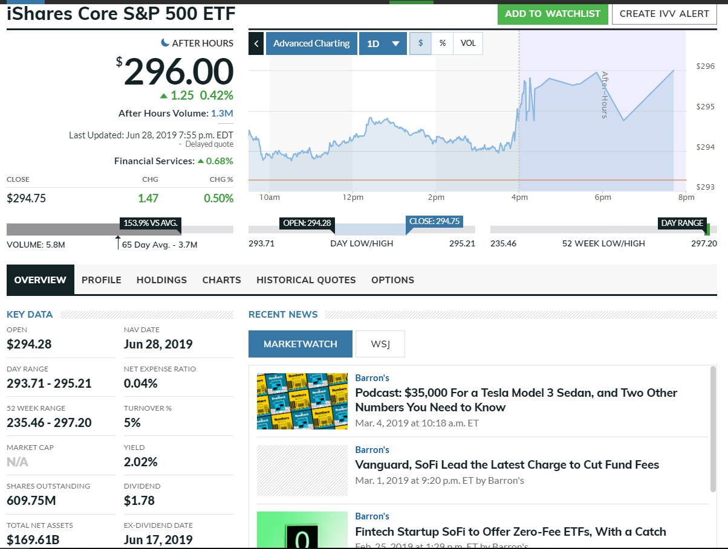
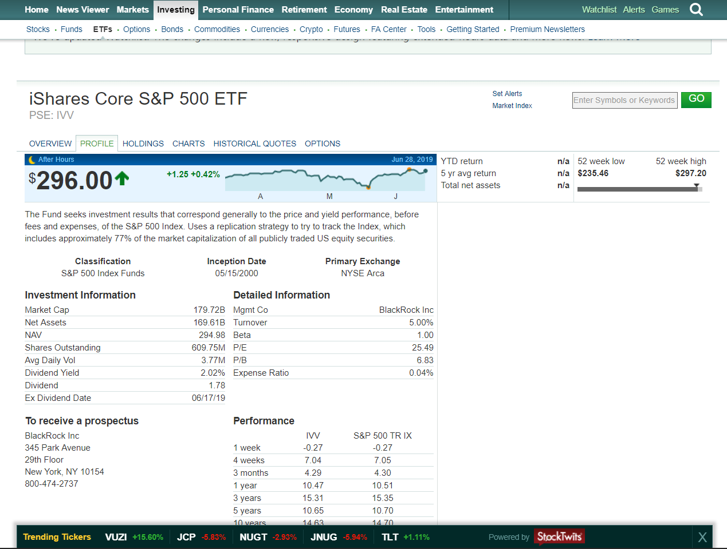
Market Watch
https://www.marketwatch.com/investing/fund/ivv/profile

Slide 8
Screeners Comparison
 | Naver | MorningStar | ETF.com | Financial Times | Yahoo Finance | MarketWatch
Price / Chart | O | O | O | O | O | O
Profile | O | O | O | O | O | O
NAV & Trend | O | O (no trend) |  |  | O (no trend) | O (no trend)
Holdings | O | O | O | O | O | O
Asset Breakdown |  | O | O | O | O | O
Trading Vol. | O | O | O |  | O | O
Trailing Return |  | O |  | O | O
Growth of 10000 |  | O
Annual Return | O | O |  |  | O | O
Benchmark |  | O | O |  | O
Risk / Rating |  | O |  | O
Performance Stats |  | O | O |  | O
MSCI ESG Ratings |  |  | O
PE Ratio |  | O | O |  | O | O
Dividend Yield |  | O | O |  |  | O
WAMC | O | O | O |  | O | O
Beta | O |  | O |  | O | O
Net Expense Ratio | TER | O | O | O | O | O
Cash Flow Growth |  | O
Ownership | O | O
Tax |  | O

